Slide 1
MOVING FROM BUD TO BOSS
The Mindset of the
Successful New Manager
FACILITATOR GUIDE

Slide 2
Moving from Bud to Boss The Mindset of the Successful New Manager
LENGTH OF COURSE: 3 Hours (breaks not included) Can be combined with other courses from Content Sundae to create a full day program.
Recommended 20-25 people max in program.
PARTICIPANT PRE-WORK: Book or book summaries can be helpful to set the framework for the workshop. Great reads for new managers include:
Mindset by Carol Dweck
The Progress Principle by Teresa Amabile
Act Like a Leader, Think Like a Leader by Herminia Ibarra
The One Thing You Need to Know by Marcus Buckingham
Dare to Lead by Brene Brown
Drive by Daniel Pink
How to Win Friends and Influence People by Dale Carnegie
MATERIALS AND PREPARATION:
Build pre and post skill surveys for the program. See resource toolkit for samples.
Identify company Executive to kick off the program and provide them with talking points. Be sure to let them know how much time they have. Review with them if appropriate. See resource toolkit.
Optional: Send a welcome video message to all participants to introduce yourself as the facilitator and provide a high level overview of what they will be learning.
Send communication support to the participants’ manager that includes:
Learning outcomes and agenda for program.
Coaching tips and questions to be discussed following the program with the participant to ensure application back on the job.
Read any books or book summaries that you assigned as pre-work.
Gather several key insights from book that you want to reference in class that ties to program.
Have an example of new management struggles that you’ve faced or a personal story to share. You can also research examples of other well known manager stories that are relevant.
Choose 1-2 videos that may help illustrate your point about a topic. Here are a few ideas:
Common reactions to the new boss: https://youtu.be/EtllWIiOTuA
Drive. The surprising truth about what motivates us: https://youtu.be/u6XAPnuFjJc

Slide 3
Moving from Bud to Boss The Mindset of the Successful New Manager
MATERIALS AND PREPARATION continued:
Tell Your Story Exercise materials:
Buzzer or bell
Blank envelopes with “do not open” written on front. Have 1 envelope for each participant.
Colored stickers. Place 1 colored sticker on the front of each envelope so that people will be able to form groups based on their color. Keep groups small (4-5 people).
In each envelope, have 1 word used to describe a great manager. Words can be duplicated if needed for different groups. Examples of words include:
Innovative, creative, honest, open, ethical, trustworthy, caring, aware, knowledgeable, strategic, mediator, problem solver, optimist, appreciative, communicative, happy, calm, focused, goal oriented, supportive, coach, expert, reliable, and so on.
Large blank postcards for Participant Created Case Studies
Prepare the following flipcharts:
Parking Lot
What Makes It Difficult?
Importance of Earning Respect
Planner Definition/Responsibilities/Success Measures
Administrator Definition/Responsibilities/Success Measures
Relationship Builder Definition/Responsibilities/Success Measures
Results Driver Definition/Responsibilities/Success Measures
Planner Challenges/Solutions
Administrator Challenges/Solutions
Relationship Builder Challenges/Solutions
Results Driver Challenges/Solutions
Have printed participant workbooks at tables
Have 1-2 flipcharts, markers, name tents, sticky notes, pens and tape (at tables if appropriate)

Slide 4
Facilitator Instructions How to Use This Guide
This course uses a variety of facilitation methods and relies heavily on activity-based learning. Accompanying power point slides and participant workbook pages will be listed on the page to the left of the instructions. To facilitate this course effectively we recommend the following:
Keep on time. Do not allow participants to stray off topic. Use a “parking lot” for off topic comments or ideas that you want to capture from participants and review at the end of the course to determine if additional follow-up is appropriate. A “parking lot” is a flipchart put up at the beginning of class that captures those “off topic” subjects.
Use the Goals section to tie ideas together to achieve the learning objectives.
The GOLD is in the Debrief. Encourage in-depth discussions and sharing of insights from both participants and facilitator after each activity to take the learning to a deeper level.
Use the Transition section to build connection and flow from one topic to another.
Topic:
Time:
Method:
Workbook Pages:
Goals:
Use to stay on track
and prepare. Quick reference for where participants should be in their workbook.
Use to set goals for the learning and to explain why this section is important.
Content Overview:
Main talking points for leading your facilitation on this topic.
Activity:
Instructions for how to run activity.
Debrief:
Instructions for how to debrief activity and tie learning to overall objectives. Expand when appropriate.
Transition:
Key talking points to transition from one concept to another and maintain flow of content. Expand when appropriate.

Slide 5
Notes
___________________________________________________________________________
___________________________________________________________________________
___________________________________________________________________________
___________________________________________________________________________
___________________________________________________________________________
___________________________________________________________________________
___________________________________________________________________________
___________________________________________________________________________
___________________________________________________________________________
___________________________________________________________________________
___________________________________________________________________________
___________________________________________________________________________
___________________________________________________________________________
___________________________________________________________________________

Slide 6
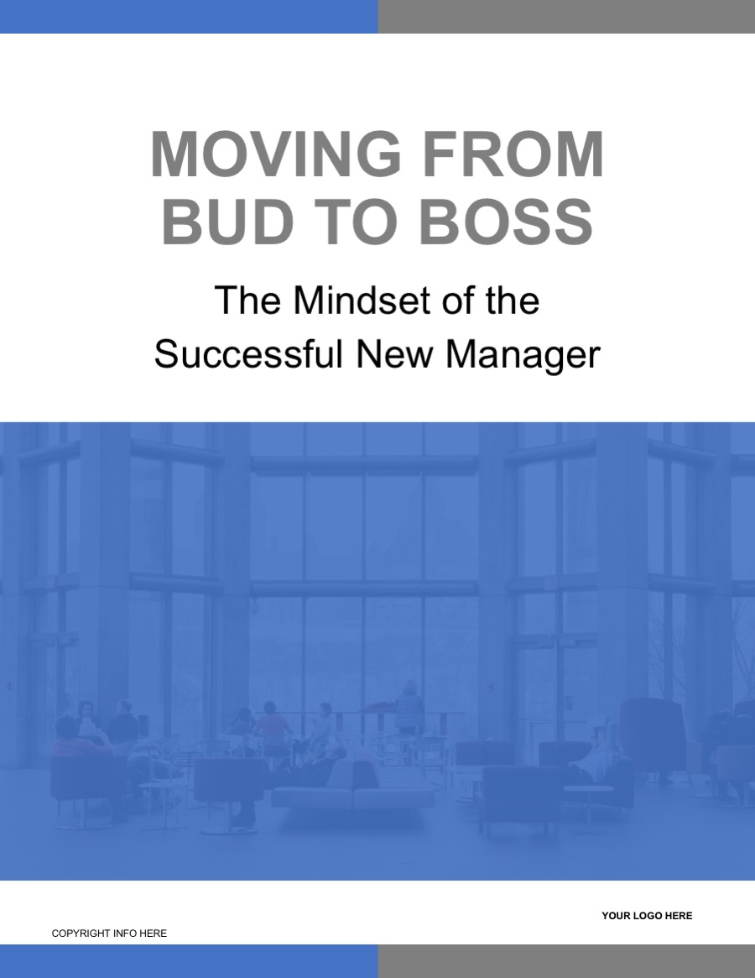

Slide 7
Slide 1-2: Outcomes and Insights
Topic: Welcome and Introduction Time: 12 minutes Method: Discussion Workbook Page(s): 1 PowerPoint Slide(s): 1-2 | Goals: To learn about new manager mistakes and how to avoid them To identify the key competencies of management To discuss challenges and opportunities for the new manager in any organization To discuss standard practices that can encourage mutual respect between the employee and manager
Content Overview: (10 mins) Have (pre) skill survey at tables. Instruct participants to assess their skill and confidence level regarding the topic before the workshop starts. You can have this instruction on a flipchart when they arrive. Make a brief personal introduction and share any relevant management experience that you have. Share a story of early management struggles and things that were difficult for you (or share a story of someone that everyone knows). Ideas include: What were your greatest obstacles or challenges? How did you feel when you became a manager for the first time? What were some of the fears and emotions that you were going through? What type of support did you have? Or didn’t have? Were you successful at first? If not, why not? Sharing these struggles and successes, emotions and fears establishes trust with the audience that you have “been there, done that”. Explain that this workshop is about self-discovery and awareness about what it takes to be an effective new manager and to validate the normal challenges that you are already facing or will face in your new role. We’ll be doing a lot of reflection, sharing and identifying where you can focus your attention on building new management skills. Review learning objectives and outcomes.
Activity: N/A
Debrief: N/A
Transition: (2 mins) Today’s interactive program will provide you with strategies and tools to step into your new role as a manager of people. You’ll get a chance to explore your current approach to managing and discover what opportunities exist for you to expand your skills and mindset. We’ll begin with a few reflection activities to get you in the mindset of what a great manager looks like and also what makes the first-time manager role challenging.

Slide 9
Slide 3: Tell Your Story
Topic: Tell Your Story Exercise Time: 18 minutes Method: Reflection and small group share Workbook Page(s): 2 PowerPoint Slide(s): 3 | Goal(s): To consider what good management practices and approaches look like based on personal experiences.
Content Overview: (1 min) In this activity, you’ll have the opportunity to Tell a Story about a great manager you’ve experienced and consider what made them effective and successful.
Activity: (15 mins) Instruct everyone to look at the colored sticker on their envelope and let them know that have exactly 1 minute to find the other people in their group with the same colored sticker. Once in groups, have each person open their envelope, use the word in their envelope to trigger a memory they have of a leader, team lead, manager, coach, etc. they have worked for, read about or admired. Each person in the group will share a 2-minute story of how a leader or manager they experienced embodied that word and share with their small group. Facilitator note: Keep track of time and ring a buzzer or bell when 2 minutes is up and let them know to switch story tellers.
Debrief: (1 min) Great managers come in many different sizes and packages. All managers have something special that makes them unique and successful. The key is to recognize your strengths and leverage that strength in your role as a manager then surround yourself with a strong team that can support you.
Transition: (1 min) Let’s continue our reflection discussion by having a brief conversation about what makes the first-time manager role difficult and why it’s so important to earn the respect of your team early and often.

Slide 11
Slide 3: Tell Your Story
Topic: What Makes It Difficult Reflection Time: 20 minutes Method: Group Discussion and Share Workbook Page(s): 2 PowerPoint Slide(s): 3 | Goal(s): Reflecting on what makes the first-time manager role difficult Reflecting on why it’s so important to earn the respect of the team early and often
Content Overview: (1 min) Being a first-time manager isn’t always easy but it certainly is a powerful learning and growth opportunity. This is a chance to share what’s been difficult for you and why it’s so important to build respect with your team every chance you get. Facilitator note: You may want to add recent statistics on why employees leave a company to support the importance of building strong relationships with employees.
Activity: (10 mins) Keep groups the same (using colored stickers on envelopes). Say: In your same groups, talk about the discussion questions in your workbook and be sure to capture your ideas. Have groups answer discussion questions from workbook
Debrief: (9 mins) Ask for group shares about what makes the first-time manager role difficult and why earning respect is so important Capture their answers on flipcharts: What Makes It Difficult? Importance of Earning Respect Share any personal insights or stories that are relevant to the difficulties of being a first time manager and the importance of earning the respect of your team.
Transition: (1 min) What we will learn today will help you become more aware of the opportunities you have to build stronger relationships with your team members, earn their respect and ideas on how to do it. Let’s start by reviewing some of the most common mistakes that new managers make.

Slide 12
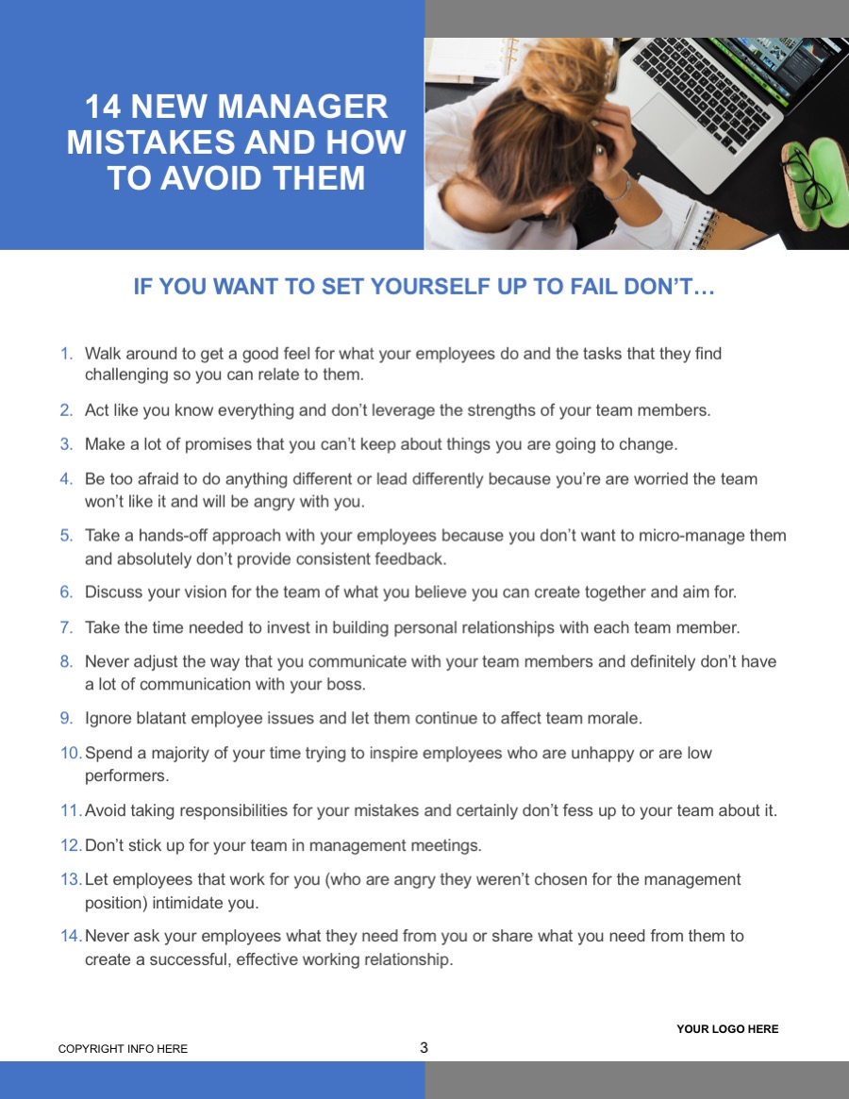

Slide 13
Slide 4: New Manager Mistakes
Topic: New Manager Mistakes Time: 15 minutes Method: Personal Reflection Workbook Page(s): 3 PowerPoint Slide(s): 4 | Goal(s): To assess where they have room for improvement and discuss common mistakes that they may be making as a new leader.
Content Overview: (1 min) Over the years, we’ve worked with a lot of new managers and we’ve summarized common mistakes that we see the most. These 14 New Manager mistakes although common, can derail your success quickly by breaking down trust and morale on your team, creating conflict and frustration and inhibiting productivity and innovation.
Discussion Activity: (10 mins) Read though these common mistakes and highlight any of these habits you may have adopted. Do any of these mistakes surprise you? Which ones? Why? What impact do you think some of these mistakes could have on your team? Your credibility?
Debrief: (2 mins) This reflection activity provides you with an opportunity to build more awareness about areas where you can improve as a manager. Approaching your new management role with an open mind to learning, growing and developing your skills is what will determine your ultimate success when leading others.
Transition: (1 min) Let’s start discovering strategies to help you avoid some of these mistakes and introduce you to the 4 key competencies that all managers need to build and focus on which include being a Planner, Administrator, Relationship Builder and Results Driver.

Slide 14
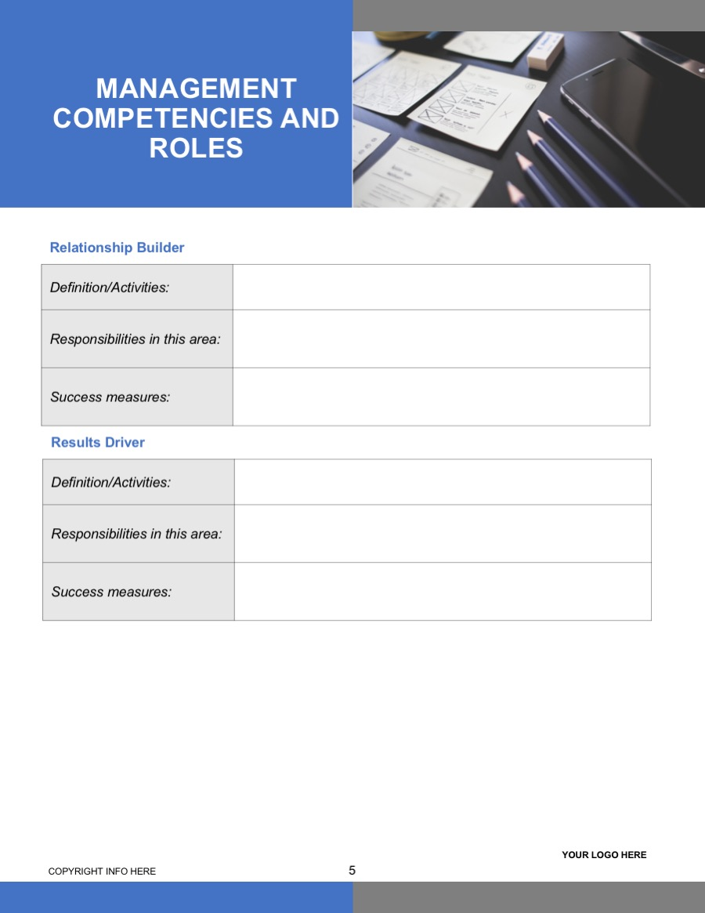
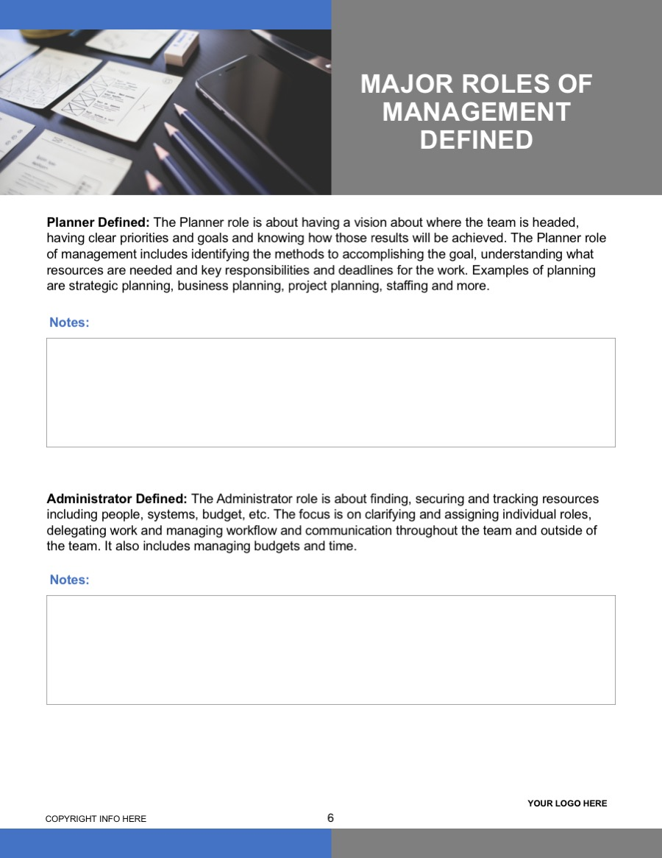

Slide 15
Slides 5-10: Management Competencies and Roles
Topic: Management Competencies and Roles Time: 25 minutes Method: Discussion, Group Activity Workbook Page(s): 4-7 PowerPoint Slide(s): 5-10 | Goal(s): To understand the key competencies of the management role in any organization.
Content Overview: (1 min) Introduce the topic by explaining that there are 4 specific areas that managers should focus on to be successful in their new role. They include: Planner, Administrator, Relationship Builder, Results Driver. These areas represent roles that the new manager is required to fill and competencies necessary to be successful in their job. As a manager, it’s necessary to spend time doing all of these things and many times new managers spend more time in one area than another or neglect a competency all together. We’ll define these competencies based on your own experience and discuss them together.
Group Activity: (10 mins) Have flipcharts ready to go for each competency area in the front of the room Ask the group the following questions for each competency and record on flipchart paper. How would you define this management competency? What activities or tasks would it include? What do you think are the responsibilities of the new manager in this area? How would you define success? What would you notice? Note: Measurement many times can be observable but there may also be metrics that the new manager can pay attention to like turnover rates, reduction in complaints, higher levels of productivity, team assessments, etc. Following discussion, review the PPT and workbook for each competency to summarize what was discussed Hang completed flipcharts around the room. Facilitator Note: Share any personal examples of the tasks you’ve performed in each area, how much time, energy and difficulty you’ve experienced.
Debrief: N/A
Transition: (1 min) Successful managers frequently assess their time management to identify what key competencies are being neglected and need a little love. They also recognize that when problems arise between team members, on a project, or with resources - that many times the solution is to revisit these competencies and consider ways to make sure they are getting the attention they need. In our next activity, you’ll choose a competency area that you struggle with the most and work with others to come up with solutions you can put into practice immediately.

Slide 16
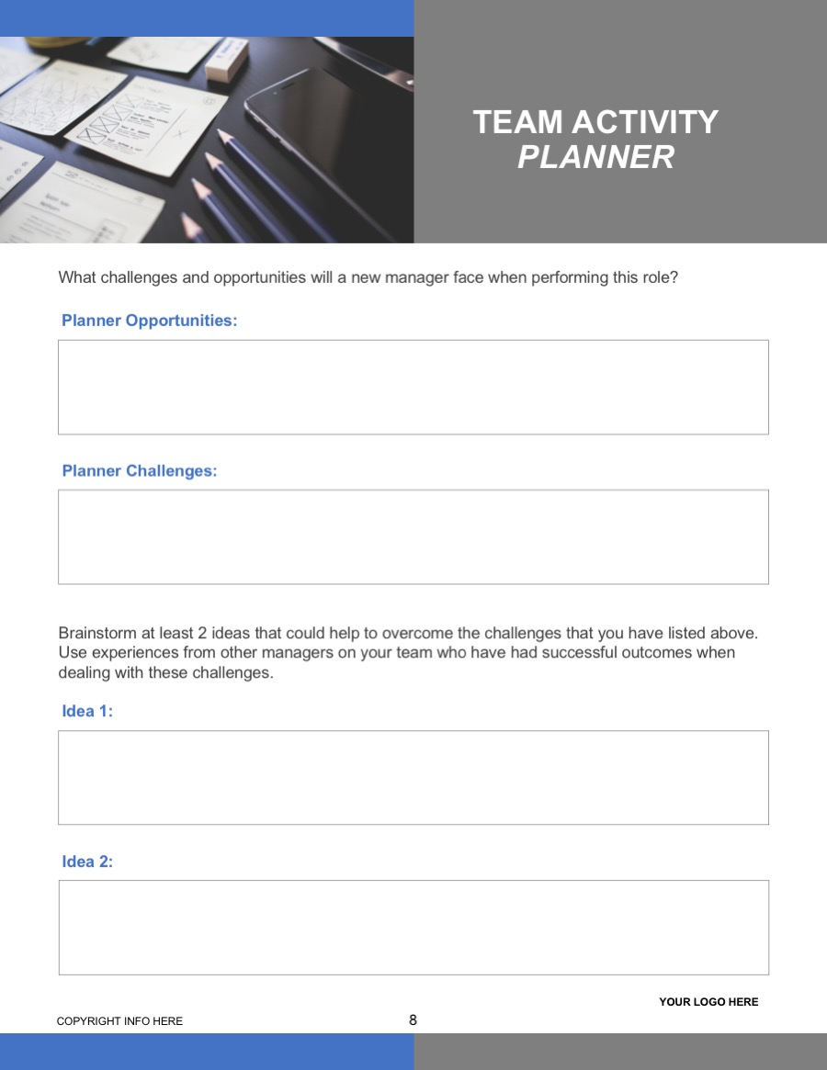
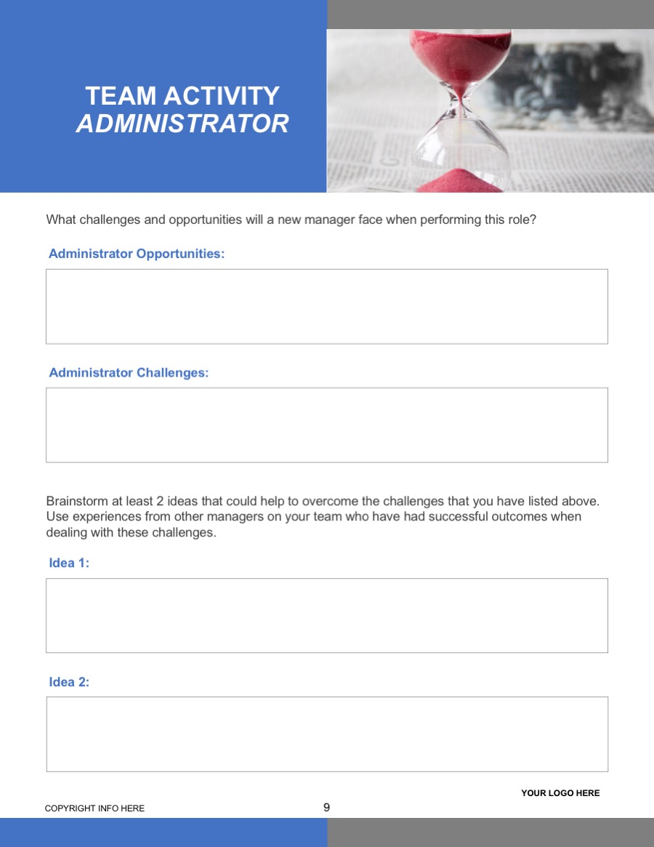
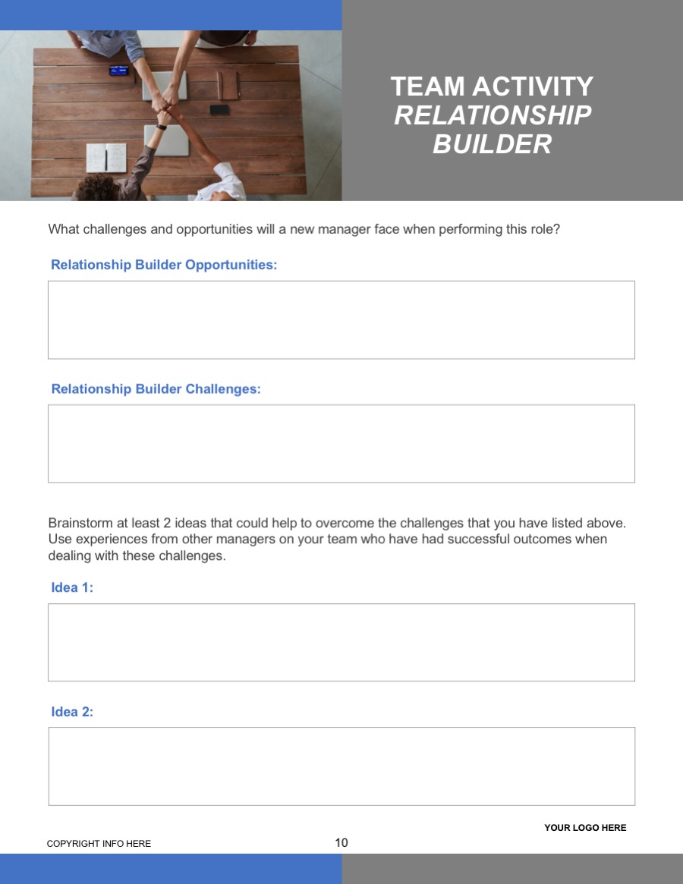
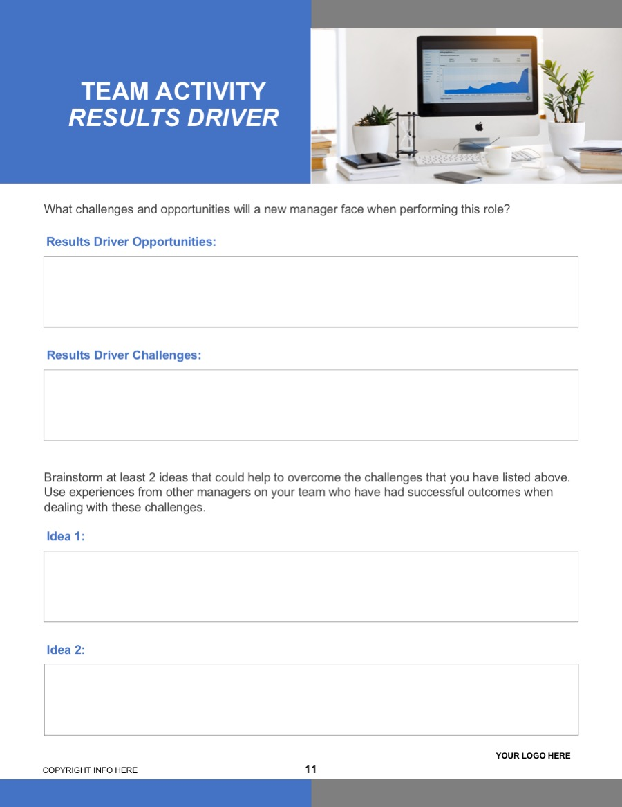

Slide 17
Slide 11: CHALLENGES AND OPPORTUNITIES
Topic: Challenges and Opportunities Time: 30 minutes Method: Facilitated Discussion, Team Activity Workbook Page(s): 8-11 PowerPoint Slide(s): 11 | Goal(s): To develop solutions to put in practice to address challenges in each of the four major competency areas of management.
Content Overview: (3 mins) Managing can be overwhelming and it certainly can feel like there will never be enough time in the day to get everything done. Being aware of where you are spending your time and what needs more of our attention as a manager is the first step to helping you gain more control of your time management and get better results Considering the 4 competencies that we just defined…. What competency area seems to be the most difficult for you? Where do you believe you’re experiencing less than stellar results because you’re not dedicating enough time to this competency area?
Challenges/Opportunities Activity: (15 mins) Instruct participants to go to the competency area that they need help with the most Have flipcharts hanging around the room for recording ideas. Challenges/Opportunities and Solutions flipcharts for each management competency Instruct groups to brainstorm both challenges and opportunities they will face when managing this function and record on flipchart paper. Have each group come up with their top 2-3 ideas to overcome the challenges they face on the Solutions flipchart
Debrief: (10 mins) Ask each group to report out and share their ideas. Encourage participants to take notes on ideas in their workbook that they would like to incorporate into their management approach or tasks. Add any pertinent information to their ideas or suggestions.
Transition: (2 mins) Thank you for these great ideas and solutions to develop yourself as new managers in these competency areas. Being a new manager can be exciting and overwhelming. It’s important to understand some of the key competencies that are required of managers in difficult situations. Take action in the competency areas that require more of your time and attention each week and you will notice significant influence on your overall success as a new manager.

Slide 19
Slide 12: PARTICIPANT CREATED CASE STUDIES
Topic: Participant Created Case Studies Time: 40 minutes Method: Case Studies, Group Discussion Workbook Page(s): 12 PowerPoint Slide(s): 12 | Goal(s): To address real life situations that new managers are facing and capture ideas for what competency areas might need more time and attention and how to build respect and trust quickly with their team.
Content Overview: (3 mins) Now we are going to bring this all together and make it real for you. I’m going to put you into work groups where you’ll get the chance to share real life scenarios of a difficult situation that you have faced as a new manager. Our goal is to help you get feedback on the situation and provide you solutions and ideas that you may not have thought of so you can be more effective as a manager when that situation arises in the future.
Case Studies Activity: (20 mins) Create new groups (4-5 groups). You can count off to put people into groups. Hand out large postcards – 1 to each group Instruct each group to come up with ONE challenging situation that someone has recently handled as a new manager. Explain the situation as succinctly as possible and outline it on the front of the postcard. IMPORTANT NOTE - they do not write down the solution or what they did in the situation Give teams 10 mins to define their challenge. Each team passes their challenge to another team (new team) The new team has to read the challenge and come up with a solution that includes: what management competencies are important in this situation and why a strategy for earning respect and building the relationship with their team what represents fair management practices Provide the new team 10 minutes to detail their solution on the back of the card.
Debrief: (15 mins) Group debrief: Each team will shares insights or good ideas that were presented that they had not thought of OR seemed to be a very innovative way to address the situation. Facilitator Notes: Share any insights or additional ideas on how to handle the challenge based on what you have experienced or seen work. You might also refer back to the ideas that were presented in the Tell Your Story activity.
Transition: (2 mins) We’ve covered a lot of ground in the short time we’ve been together. Now is an opportunity to think about everything we discussed and you learned today and consider where your greatest opportunities are to develop your management skills. Our final activity is to do a self-assessment and action plan so that you can walk out of her with a set of next steps that you will share with your team and your manager.

Slide 20
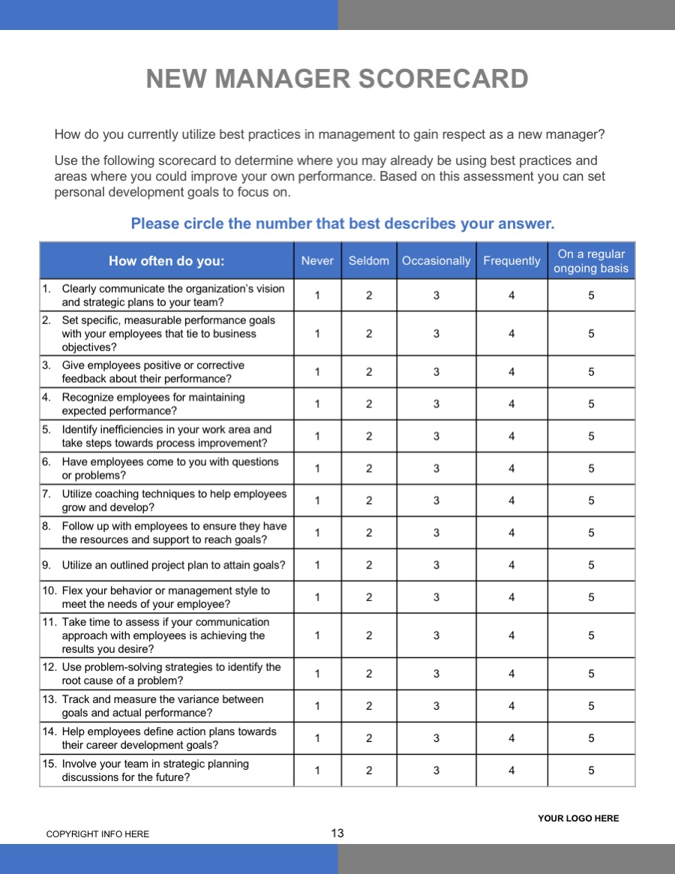
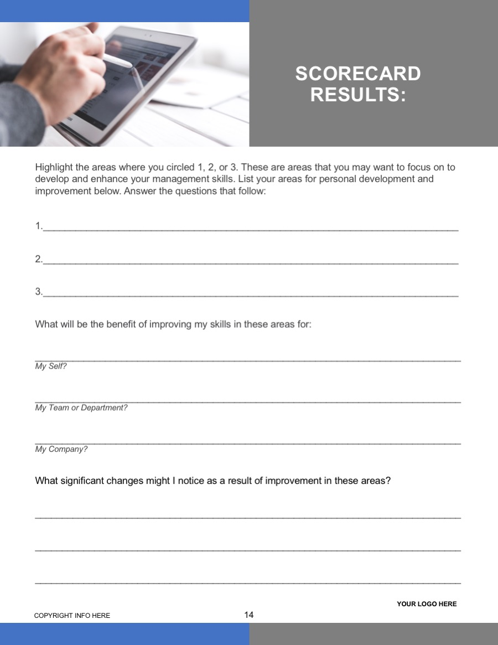
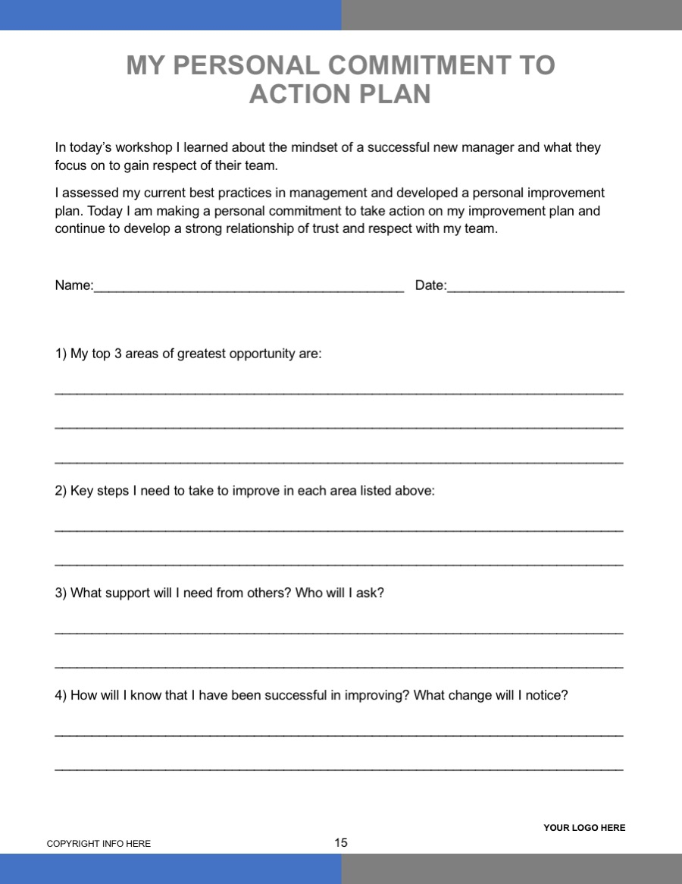

Slide 21
Slides 13-16: NEW MANAGER SCORECARD
Topic: Manager Self Assessment and Close Time: 20 minutes Method: Self Assessment & Action Planning Workbook Page(s): 13-15 PowerPoint Slide(s): 13-16 | Goal(s): To assess their current opportunities for management development, management approach and improving their communication/feedback skills with their respective teams. To develop and share an action plan.
Content Overview: N/A
Scorecard Activity and Action Planning: : (10 mins) Instruct each participant that they are going to do a quick self-assessment of where they are today in terms of applying management best practices in their role. Have them answer the questions about their assessment on the corresponding pages in the workbook and consider any additional insights or a-ha’s they had today to develop their action plan. Instruct participants to turn to a partner at their table and share their action plans with one another and choose a time/date when they plan to share it with their team and manager. Ask for a few personal shares (2-3) from the group.
Debrief: (5 mins) Small shifts in behavior, attitude, mindset, communication can create big results and positive changes that will surprise you as a manager and leader. However, it’s up to you to commit to these action plans. Remember that the definition of insanity is doing the same thing over and over again and expecting a different result. Committing to these action plans requires practice, feedback and sharing with others. We encourage you to share these action plans with your manager and your team after today’s session so that they can support you and hold you accountable. We also recommend that you come back to this Management Scorecard at least 2x per year and assess what’s working for you and where you still have room to grow.
Close: (5 mins) Review/summarize what was covered Have (post) skill survey at tables. Instruct participants to assess if their skill and confidence levels have changed regarding the workshop topic. Collect all completed surveys Thank participants for coming Handout or provide an electronic evaluation of the workshop. Ask participants to complete before they leave.

